Slide 1




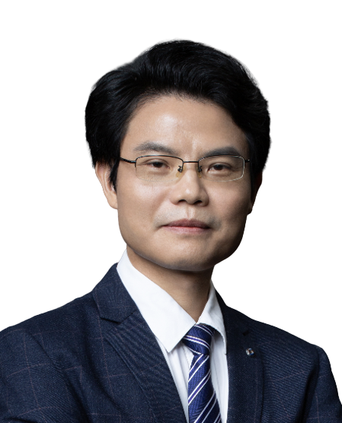

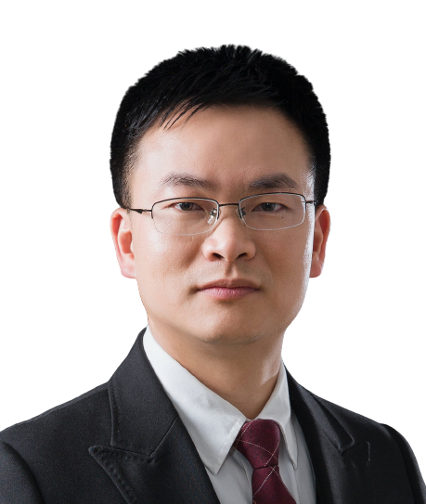




RNA regulation and male reproductive development
Time：2024-01-10 14:30-16:30PM
Meeting ID: 771-988-232
Bilibili： https://live.bilibili.com/26427894
Mofang Liu
Center for Excellence in Molecular Cell Science, CAS
Researcher Mofang Liu Profile :
Mofang Liu is a researcher at the Center for Innovation and Excellence in Molecular and Cellular Sciences. Her primary research encompasses RNA regulation and male reproductive studies, and she aims to shed light on the unknown causes behind more than half of male infertility, which has emerged as a global social concern.
Her concentrated efforts in RNA regulation, spermatogenesis, and male infertility have yielded a series of original and significant research breakthroughs. Notably, her work unveiled the piRNA regulatory pathway's abnormality as a novel contributor to male infertility. She also revealed fresh insights into mRNA translation regulation, sperm cell clearance, and degradation mechanisms. Her contributions include unravelling multiple mysteries in spermatogenesis, proposing novel theories, and advancing our comprehension of male reproductive patterns and the origins of male infertility.
As a corresponding author, she has authored over 30 articles published in renowned journals such as Science, Cell (2), New England Journal of Medicine, Nature Cell Biology, Molecular Cell, and Developmental Cell, among others. Recognized as one of the leading researchers in RNA regulation and reproduction, she was recently invited by Nature Reviews Molecular Cell Biology to conduct a comprehensive review of PIWI/piRNA research progress.
Additionally, Liu is Deputy Editor-in-Chief of 'Chinese Science: Life Sciences,' the Director of the RNA Professional Committee, and the Chief Scientist for key research and development programs under the Ministry of Science and Technology and significant basic research initiatives in Shanghai. She has been honored with the Shanghai First Prize in Natural Science, the First Prize in Natural Science of the National Science and Technology Award for Women's and Children's Health, and the Tan Jiazhen Life Science Innovation Award.
HOST＆PANELISTS
Host: Jianhua Yang
Sun Yat-Sen University
Zhichao Miao
Guangzhou Laboratory
Guangzhou Medical University
Lin Huang
Sun Yat-Sen Memorial Hospital,
Sun Yat-Sen University
Jinkai Wang
Zhongshan School of Medicine,
Sun Yat-Sen University
Sponsors

Slide 2

RNA调控与雄性生殖发育
报告时间：2024-01-10 14:30-16:30 PM
腾讯会议ID: 771-988-232
Bilibili： https://live.bilibili.com/26427894
刘默芳
研究员
中科院分子细胞科学卓越创新中心
刘默芳研究员简介：
刘默芳，中科院分子细胞科学卓越创新中心/生化细胞所研究员、PI；国家杰青、“万人计划”领军人才和新基石研究员获得者。主要从事RNA调控与雄性生殖研究，面向国际前沿和人口健康，针对精子发生极其复杂并有许多未解之谜、男性不育一半以上病因不明并已成为全球性社会问题等，聚焦RNA调控与精子发生和男性不育，获得了系列原创重大研究成果，包括首次证明piRNA调控通路异常是男性不育新病因、揭示了精子细胞mRNA翻译调控和清除降解新机制等，解答了精子发生中多个未解之谜，提出了新的理论，提升了对雄性生殖规律和男性不育病因的认识；发表学术论文80多篇，包括以通讯作者在Science、Cell (2篇)、New Engl J Med、Nat Cell Biol、Mol Cell、Dev Cell 等的30多篇；成果入选“国家重点研发计划重大科技成果”、“中国生命科学十大进展” 、“中科院科技亮点成果（2次）等；作为RNA调控与生殖领域主要引领者之一，近期受邀Nat Rev Mol Cell Biol长文综述，系统总结了PIWI/piRNA研究进展。担任《中国科学：生命科学》副主编、RNA专业委员会主任、科技部重点研发计划和上海市重大基础研究项目等项目首席科学家，获上海市自然科学一等奖、全国妇幼健康科学技术奖自然科学一等奖、谈家桢生命科学创新奖等荣誉。
HOST＆PANELISTS
主持人：杨建华
中山大学
苗智超
广州实验室
广州医科大学
黄林
中山大学孙逸仙纪念医院
王金凯
中山大学中山医学院
Sponsors

